Slide 1
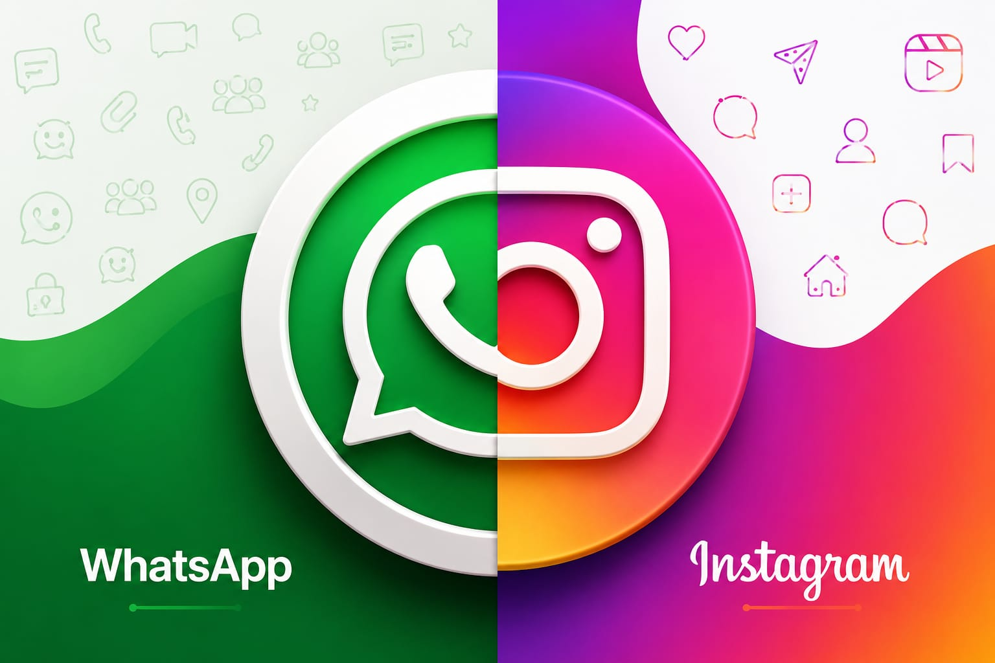

Slide 2
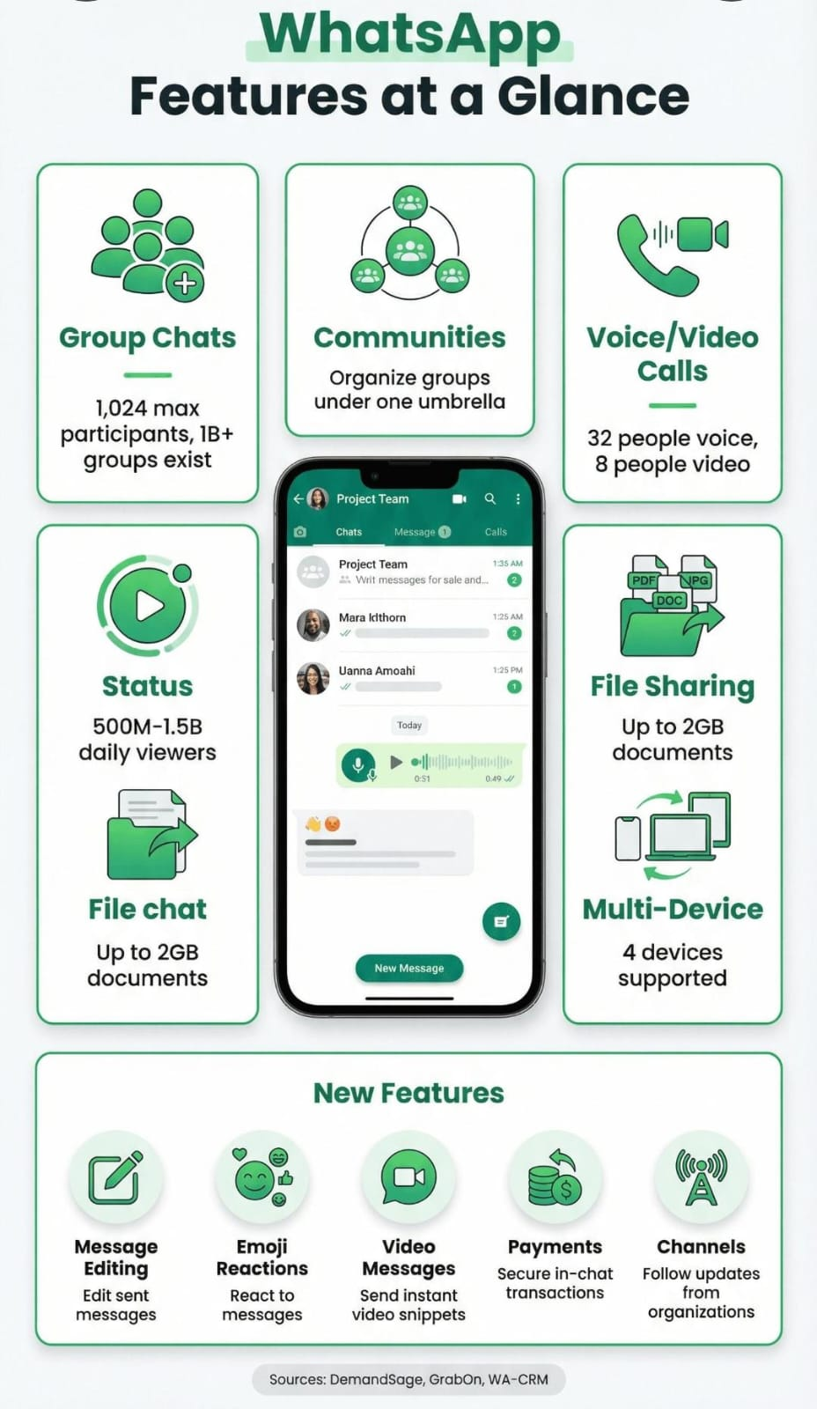

Slide 3
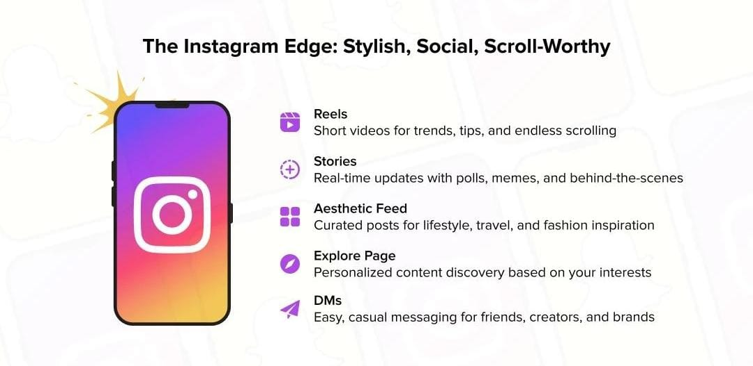

Slide 4
Instagram vs whatsapp
Communication
Friends,family,groups
Messages& Media
Chats & calls
Whatsapp Groups
More private communication
Content sharing
Creators,friends
Photos & videos
Comments & DMs
Instagram Reels
More public/social

Slide 5
Whatsapp advantages & disadvantages
Advantages
*Fast communication
*Easy group conversations
*Voice/video calling
*Easy file sharing
Disadvantages
*Can receive unwanted messages
* Group notifications can be distracting

Slide 6
Instagram advantages & disadvantages
Advantages
*Creative content
*Entertainment
*Helps creators and businesses reach
People
*Easy to discover new content
Disadvantages
*Can be distracting
*Too much screen time
*Public content can affect privacy

Slide 7
WHATSAPP & INSTAGRAM
BETTER FOR
BETTER FOR
* Communication
* Entertainment & content sharing

Slide 8
THANK YOU

